Slide 1
Chapter 3
Object-Oriented Concepts with
Examples

Slide 2
OOD TO OOP
The strength of The Object-Oriented paradigm is that it is used in analysis (OOA), design (OOD) and Programming (OOP). Same classes can be used in
all 3 levels.
In this chapter, we will introduce OO design and
implementation concepts with code examples. Some of the concepts that will be introduced: Abstraction, Inheritance, encapsulation, binding, boxing, overloading, etc.

Slide 3
Object Oriented
Everything is an object.
A program is a bunch of objects telling each other what to do by sending messages.
Each object has its own memory .
Every object has a type (class).
All objects of a particular type (class) can receive the same messages.

Slide 4
Before Object Oriented Programming
Before OOP, programming was procedural
(Fortran, Pascal, C, etc).
Program started at some fixed point and then invoked a series
of subroutines (functions) in sequence to produce the desired
results.
Codes and functions were mixed.
Not suitable for large complex software.
Difficult to maintain and debug.
Life of a programmer was much more stressful before OOP came to the rescue.

Slide 5
Abstraction and ADT
Abstraction is the process of exhibiting only the
essential characteristics of an object depending on
programmers view.
In design abstraction, we focus on the important
relevant information and ignore unnecessary details.
Abstract Data Type (ADT) is an idealization of a set of values, along with a set of functions and relations on these values that together constitute a type. Simple examples include Integers, Sets, Lists, and so on.
Class == Encapsulated ADT

Slide 6
Abstraction is one of the important design characteristics and techniques of reducing complexity. By focusing only on important data and processes to the project and ignore any irrelevant details, we reduce the system complexity.
As a system designer, you should always use abstraction to hide system complexity and show users only what they need to know.
Types of ADT:
Built-in types are examples of this, e.g. types for integers, floating point numbers, and characters.
We define our own types whenever we create a class, struct, record, etc.

Slide 7
System can include several levels of abstractions. It can be applied to both data and procedures.
Procedural abstraction: the separation of what a function/module does from how the function accomplishes its purpose.
Data abstraction: separation of the logical view of a data object (what is stored) from the physical view (how the information is represented).

Slide 8
ADT Examples
SET Example
The SET ADT is a collection of data items that are accessed by operations such as: Union, Intersection, and Set Difference.
Example: String ADT is an ordered sequence of characters with operations concatenate, length, compare, substring, etc.
LIST example
new List returns an empty List, []
list.add(a)adds a to the end of the list [original_elements, a]
get(x) returns the element at position x in the List
size()returns the size of the Lis.

Slide 9
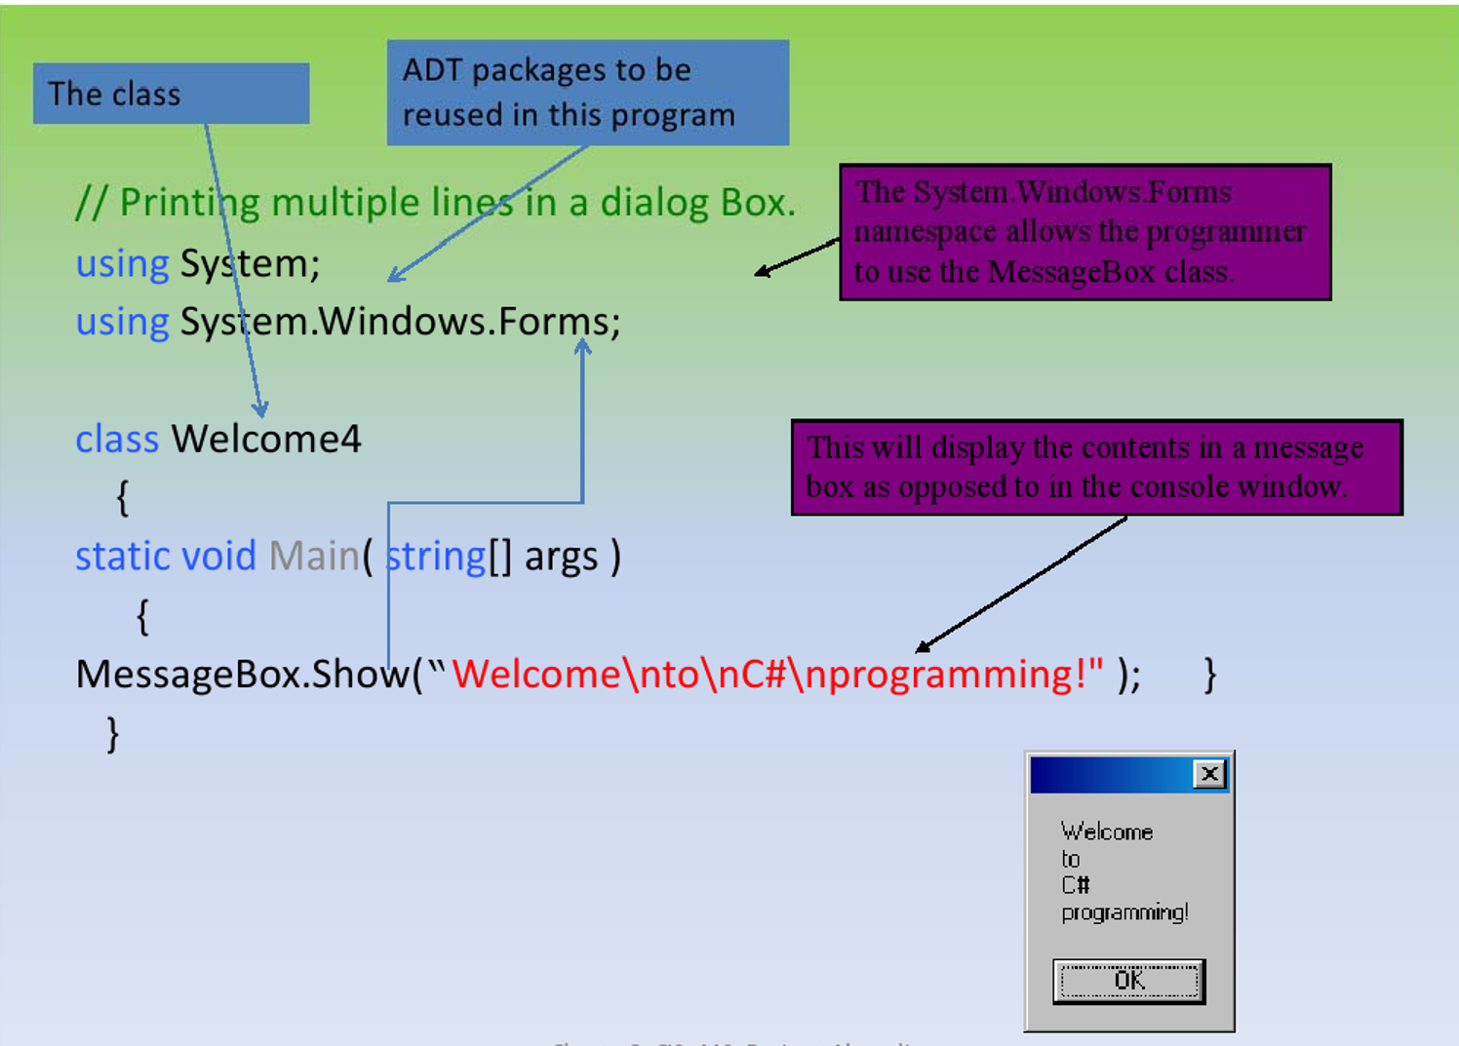

Slide 10
Modularity
Aspect of syntactically grouping related declarations. (E.g., fields and methods of a (data type.)
Package/class in Java.
In OOPLs, a class serves as the basic unit for decomposition and modification. It can be separately compiled.

Slide 11
Namespaces
Method of grouping elements (such as classes and other namespaces) to avoid naming collisions.
Namespaces are also in C++ .
Syntax for accessing elements belonging to a namespace is the . operator
Namespaces are meant for HUGE programs and frameworks .
In a huge program with different modules designed by different companies there may be classes with the same name.
If each company uses their company name as their namespace, naming collisions are reduced substantially (full names of classes, not only their own name).

Slide 12
Namespace Example 1
Namespace X {
Namespace IND {
Class Student
{
{
Class W
}
{
{
}
Include X
Using X.IND
Main
{
IND.Student S1
{
Namespace JO{
Class Student
{
{
Class W
}
{
{

Slide 13
Assembly
Classes may be compiled into .exe or .dll, such files are called assemblies and are the packaging units of C#
An assembly is composed of four sections
Manifest
type metadata
program code (in MSIL format)
resources used by the program

Slide 14
Manifest
Contain information about the assembly itself
Type matadata
information about the data types used by the program
Program Code
stored in MSIL (Microsoft Intermediate Language) format
Resources used by the program
such as .bmp or .jpg files

Slide 15
Inheritance
“If class B inherits class A, then both operations and the information structure described in class A will become part of class B”.
Show similarities, Reuse common descriptions 'Software Reuse‘
Easy modification of model by performing modification in one place
Avoid redundancy, leading to smaller and more efficient model, easier to understand

Slide 16
Inheritance addresses the idea of re-use often we need to write a program that is like, but not exactly the same as another program
Inheritance allows one class to "inherit“ members of another class
Inheritance typically involves replacing some members via "overrides"
The language designer has to decide whether or not to allow multiple inheritance

Slide 17
Single Vs Multiple Inheritance
Single inheritance: a new class is a subclass of a single parent relationships shown in derivation tree
Multiple Inheritance: a new class has more than one parent class relationships shown in derivation graph
One disadvantage of inheritance for reuse: Creates interdependencies among classes which complicate maintenance

Slide 18
Inheritance Example in C++
class base_class {
private:
int a;
float x;
protected:
int b;
float y;
public:
int c;
float z;
};
class subclass 1: public base_class { ... };
// In this one, b and y are protected and
// c and z are public
class subclass_2 : private base_class { ... };
//In this one, b, y, c, and z are private,
//and no derived class has access to any
// member of base_class
Inheritance symbol in C++

Slide 19
Class Inheritance
Class Inheritance
class <class_name>:<super_class>
Eg.
public class Car
{...}
public class Volvo:Car
{...}
Q: Which class has no super class?

Slide 20
class Bird {...
fly() {...}
{...
Specialization can override methods
class Animal {...
move() {...}
{...
class Bird extends Animal }…
move() {...
fly();
…}
…}
Inheritance methods case:
1. Same name in parent
and child - overriding
or polymorphism
2. In parent not in child,
reuse
3. In child, not in parent,
adding new features

Slide 21
Information Hiding
An ADT must obviously have some kind of representation for its data
The user need not know the representation
The user should not be allowed to tamper with the representation
Solution: Make all data private
But what if it's really more convenient for the user to have direct access to the data?
Solution: Use setters and getters ( as a proper way of accessing data )

Slide 22
public class Heater
}
private int TemperatureInternal;
public int Temperature
}
get {returnTemperatureInternal;}
set {
if (! InRange (value))
{throw new ArgumentException
(“Temperature out of range");
}
TemperatureInternal = value;
Notify Observers;
{
{

Slide 23
Encapsulation
Original motivation: Large programs have two special needs:
1. Some means of organization, other than simply division into
subprograms
2. Some means of partial compilation (compilation units that are smaller than the whole program)
Obvious solution: a grouping of subprograms that are logically related into a unit that can be separately compiled (compilation units)
These are called encapsulations.
Controlling visibility of names. It Enables enforcing data abstraction
Conventions are no substitute for enforced constraints.
Enables mechanical detection of typos that manifest as
“illegal” accesses. (e.g. problem with global variables)

Slide 24
Encapsulation
A concept of ‘Self-containing'
Information hiding - 'internal structure is
hidden from their surroundings
Behaviour and information is represented or
implemented internally
Functionality and behaviour characterized by
'interfacing' operations.
The essential features of an ADT are that its
interface is independent of its implementation
and its implementation is hidden from its users

Slide 25
Encapsulation
Encapsulation in C: Files containing one or
more subprograms can be independently
compiled
The interface is placed in a header file
Encapsulation in C++: Similar to C
Addition of friend functions that have access to
private members of the friend class
C# Assembly: Collection of files that appears to
be a single dynamic link library or executable
Larger construct than class; used by all .NET
programming languages

Slide 26
.NET Common Class Modifiers
The 7 class modifiers are public, protected,
internal, private, abstract, sealed, and new
Abstract – cant be instantiated. It is designed
only to be a base class for inheritance
Sealed – cant be inherited from.
Public – available to externals
Internal/Friend
– A class that is only accessible by code in the same project
– Although not the same, it is similar to package keyword in java
Private : unavailable for externals

Slide 27
The 'new' keyword can be used for ‘nested’
classes. A nested class is one that is defined in the
body of another class.
It is in most ways identical to a class defined in
the normal way, but its access level cannot be more
liberal than that of the class in which it is defined.
A nested class should be declared using the 'new'
keyword just in case it has the same name as (and
thus overrides) an inherited type.
Friend and internal are the same. Friend is used in
VB.NET and Internal is used in C#.

Slide 28
Binding
Binding is the association of an object to its attributes,
operations, or name
There are many different types of bindings and bindings can occur at different times, for example:
- design time binding: binding * to multiplication
– language implementation time binding: int size and operations
- compile time binding: binding type to a variable
• for instance in int x; x will be treated as an int from here forward
- link time binding: binding function name to a specific function definition
- load time binding: binding variable to memory location
– run time binding: binding variable to memory location or bind a polymorphic variable to specific class type
Binding is static if it occurs before run time and remains unchanged, otherwise binding is dynamic

Slide 29
Dynamic Binding
Static almost always means fixed or bound at compile time, and cannot thereafter be changed.
Dynamic almost always means not fixed or bound until run time, and therefore can change during the course of execution.
dynamic binding addresses the idea of polymorphism
polymorphism is a powerful way to write code that has multiple identities (typically a general and a specific)
The real gain is having code that can deal with the general type and requires no change to deal with a new specific type that can also behave like the general type

Slide 30
Dynamic Binding Example
class Eg {
public static void main (String[] args) {
Rectangle [] rs = { new Rectangle(5,6),
new ColoredRectangle(Color.red,1,1),
new Square(3)};
for (int i = 0; i< rs.length; i++)
System.out.println( rs[i].perimeter() );
{{

Slide 31
public class Mammal{
void speak() {
System.out.println("Ohhh!");
}
}
public class Dog extends Mammal {
void speak() {
System.out.println("Woof!");}
}
public class Test {
public static void main(String[] args) {
Mammal pet = new Mammal();
Dog fido = new Dog();
pet = fido;
pet.speak();
} }

Slide 32
Difference between static and dynamic bindings
Static binding can be also called early binding, while dynamic binding is called late binding.
Efficiency - static binding uses least CPU cycles, dynamic binding requires more time.
Error detection - static binding permits errors to be caught at compile time (strong typing) rather than run-time (weak typing).
Flexibility - dynamic binding permits greater flexibility, static binding creates rigidity and inhibits reuse.

Slide 33
Polymorphism - Overriding
Determining at run-time which function / method to call
Letting an object determine which function / method is appropriate.
Normal situation: Compiler determines which method / function to call or bind (early, runtime or static binding)
Polymorphic situation: Compiler is unable to determine which method to call; binding is deferred until the program executes (late, run-time, dynamic binding).

Slide 34
Polymorphism
Same object has different implementations A concept in type theory
A Polymorphic procedure comes in more than one "flavour" - the type, and possibly the number of formal parameters is not fixed, so different calls to the same named procedure invoke different actual code
Polymorphism - "many forms”.
A common name may denote instances of different classes
One type of operation can be implemented in different ways by different classes
Overloading in modern OO language

Slide 35
A very strong tool for allowing system designers to develop flexible systems
Designer only need to specify what shall occur and not how it shall occur
To add an object, the modification will only affect the new object, not those using it.
Animal a;
a = new Eagle(...);
a.move(destination);
a = new Kiwi(...);
a.move(destination);
a can be asked to do anything Animal (or a superclass of Animal) has as a public method (and nothing else)
But what happens when you ask a to move()depends upon the type of the actual object (Eagles fly, Kiwis run).

